Slide 1
We will start at 12:00 UTC

Slide 3
00. Navigating Microsoft Teams
Presenter: Andrej Kyselica
00.1 Instructions regarding meeting participation using AGM Congress Voting application.
00.2 IJRU is recording this meeting, private recording is prohibited.
00.3 Raising hand's function
00.4 Use of chat box

Slide 4
01. Roll Call - Janet Locke
01.1 IJRU Board of Directors
01.2 2022 NGB Attendance vote will serve as the roll call, (Delegate 1 will answer) (60 seconds to vote)
01.3 Guests, Andrej Kyselica, Monica Foster, Don Lui, Ann Nordin

Slide 5
02. Welcome and Opening of the Statutory 2022 General Congress
Shaun Hamilton, IJRU President
02.1 Declaration the 4th IJRU General Congress is Convened
02.2 Conflict of Interest Statement

Slide 6
03. Agenda of the 4th IJRU General Congress
Motion 1:
To accept the 4th IJRU General Congress Agenda as amended

Slide 7
04. Approval of 2021 General Congress Minutes
Motion 2:
To accept the Minutes of the 2021 IJRU Virtual General Congress

Slide 8
05. President’s Address
Shaun Hamilton – IJRU President
"It's Time to Jump In"

Slide 9
06. Membership
06.1 New Full Status
06.1.1 Greece - “Hellenic Cheerleading Federation”, HCF
Motion 3: To approve the Hellenic Cheerleading Federation as a Full Member of IJRU.

Slide 10
06. Membership
06.2 New Provisional Status
06.2.1 Somalia - "Somali Jump Rope Federation", SJRF
Motion 4: To advance “Somali Jump Rope Federation" to Provisional Status.
06.3 Sanctions
06.3.1 Russian Rope Skipping Federation

Slide 11
06. Membership
06.4 Membership Update
63 Total members
26 Full members (40+ is the goal we have been chasing)
25 Provisional members
12 Observer status members
06.5 2023 Membership Fee Restructure

Slide 12
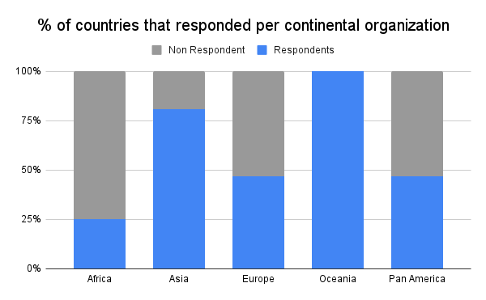
6.6
MEMBERSHIP SURVEY
Data shown in this presentation reflects survey responses as of Sept 17, 2022
Recently we contacted all NGB's to update contact details and collect important data.
Thank you to the 50% of NGB's that replied (shown in blue below). Engaging with our correspondence makes sure that your voice is heard and that we always have up to date contact information to engage with you about the exciting things that are happening within our sport.
If you did not receive this survey that means, we do not have the most up to date contact information.

Slide 13
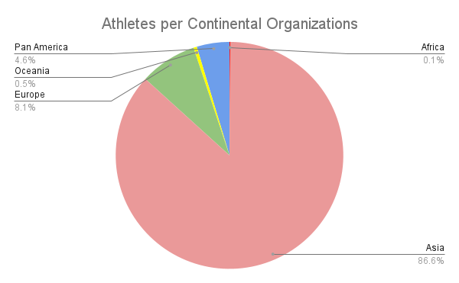
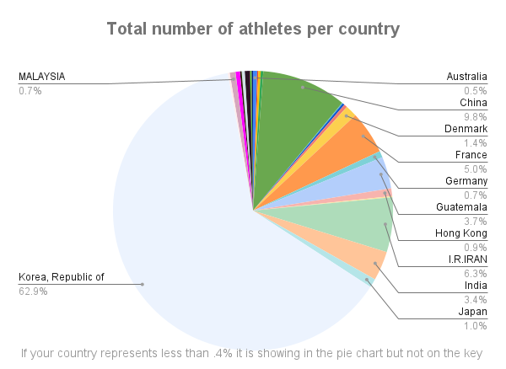
SURVEY RESULTS
Total Athletes 177,182
23,058 Competitive athletes
154,124 Non-Competitive athletes
(33 countries)
How is this data collected?
60.6% of countries collect details through registration systems or membership surveys
27.3% of countries use competition data
6.1% communicate directly with clubs and schools
6.1% have no formal process

Slide 14
Other statistics collected.......
Only 48% of NGB's have an active Athlete Council
This is concerning as we are an athlete focused organization. We need to make sure that
athlete voice is at the center of everything we do.
90% of NGB's hold an Annual General Meeting.
18 out of 33 countries currently encourage athletes to register on ADEL
We have sent information out regarding this previously but you can find
more information at https://adel.wada-ama.org/learn
4 out of 31 countries currently register athletes in ADAMS
This will be a requirement to compete at the IJRU World Championships series in
Colorado Springs, 2023.
Please visit https://adams-help.wada-ama.org/hc/en-us for more information.

Slide 15
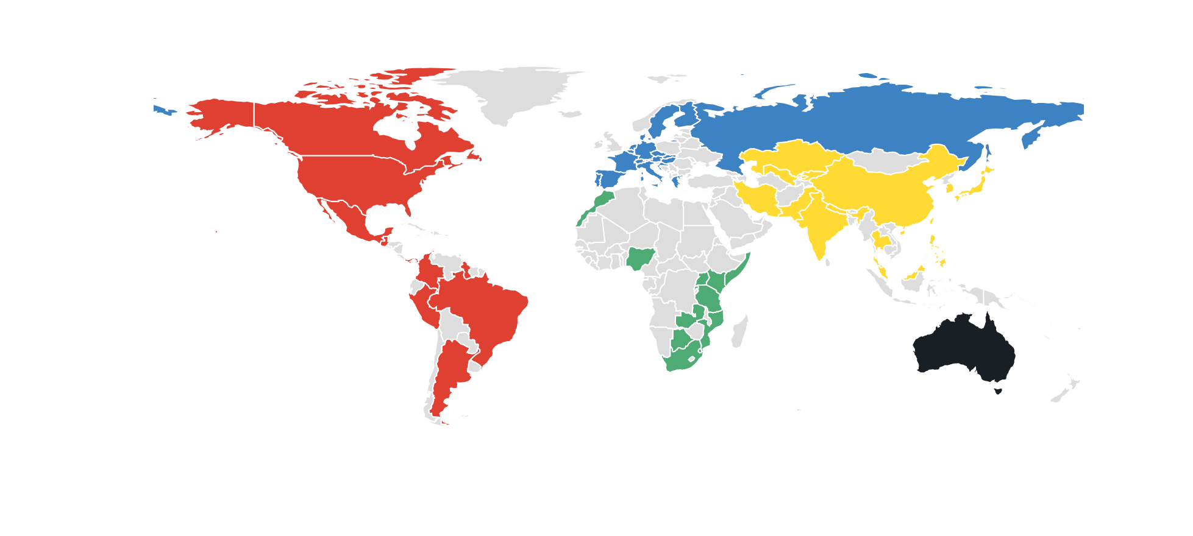
Of the 33 NGB's that replied to the survey, 30 are hoping or planning to attend the IJRU World Championships in Colorado Springs, 2023
When asked which competition they will enter;
26 countries said yes to World Championships,
24 said yes to Junior World Championships,
22 said yes to the International Open Tournament
2023
IJRU
WORLD
CHAMPIONSHIPS
Colorado Springs U.S.A
Depending on available positions, countries planning to attend gave
approximate numbers which would see
900+ athletes coming to WC,
500+ coming to JWC and
600+ coming to the IOT

Slide 16
Make sure your voice is heard! Make sure we have your latest details. If you see your country listed below, we don't have your data. PLEASE, support us to support you by filling in the survey within the next 48 hours
Botswana
Kenya
Mozambique
Nigeria
Rwanda
Eswatini
Tanzania
Uganda
Zambia
Kazakhstan
Kyrgyzstan
Malaysia
Pakistan
Belgium
Croatia
Greece
Italy
Malta
The Netherlands
Russia
Slovakia
Sweden
Switzerland
Antigua and Barbuda
Argentina
Barbados
Bermuda
Guyana
Mexico
Panama
Trinidad and Tobago
Click here to fill in the survey

Slide 17
07. Finances
07.1 Interim Treasurer Report
07.2 Audits
07.3 Current Financial Position
07.4 Forecasted budget 2023

Slide 18
08. Constitution and Policy
08.1 Constitution Amendments
Motion 5:
It has been proposed to approve the amendments to the IJRU Constitution regarding board member roles, duty and terms clarity in section C17 as proposed by the Ethics Panel.
08.2 Election Procedure – Informational Update

Slide 19
10 MINUTE BREAK TIME

Slide 20
General Congress to Re-establish Quorum
WELCOME BACK!
At this time,
Voting Delegates will be instructed on how quorum for the 2nd half of the meeting will be established

Slide 21
09. Board of Director Activities
09.1 Board of Directors Vacancies
09.1.1 Africa (1)
09.1.2 Asia (1)
09.1.3 Europe (0)
09.1.4 Oceania (0 positions available)
09.1.5 Pan America (1)
09.1.6 Athlete Council Member (1: Female athlete)

Slide 22
09. Board of Director Activities
09.2 Board of Directors Position Update
09.2.1 Pan America – Patricia Muñiz
09.2.2 Europe – Ekaterina Libova
Motion 6: It has been proposed that the General Congress accept the decision of the IJRU Board of Directors to remove Ekaterina Libova from the IJRU BOD position as Member At Large, Europe.

Slide 23
09. Board of Director Activities
09.3 Newly appointed Members
09.3.1 Luke Winstanley, Treasurer – (Australia)
09.3.2 Maria del Sol Rodriguez Lopez - At Large Member Pam Am- (Mexico)
09.3.3 Europe: Kurt Moens - At Large Member, Europe-(Belgium)
09.3.4 Europe: Nadia Aidli - At Large Member, Europe- (France)
Motion 7: It has been proposed that the IJRU General Congress ratify the following BOD appointments of Luke Winstanley to Treasurer.
Motion 8: It has been proposed to ratify Maria Del Sol Rodriguez Lopez, Pan American, At Large Member. Kurt Moens and Nadia Aidli as European At Large Members pending their NGB is in good standing.

Slide 24
10. Continental Reports
10.1 Asian Jump Rope Union (AJRU)
10.2 European Rope Skipping Organisation (ERSO)
10.3 Africa – Africa Jump Rope Federation (AJRF)
10.4 Oceania- Organisation yet to be named
10.5 Pan America – Pan American Jump Rope Federation (PAJRF)

Slide 25
11. IJRU Technical Congress Updates

Slide 26
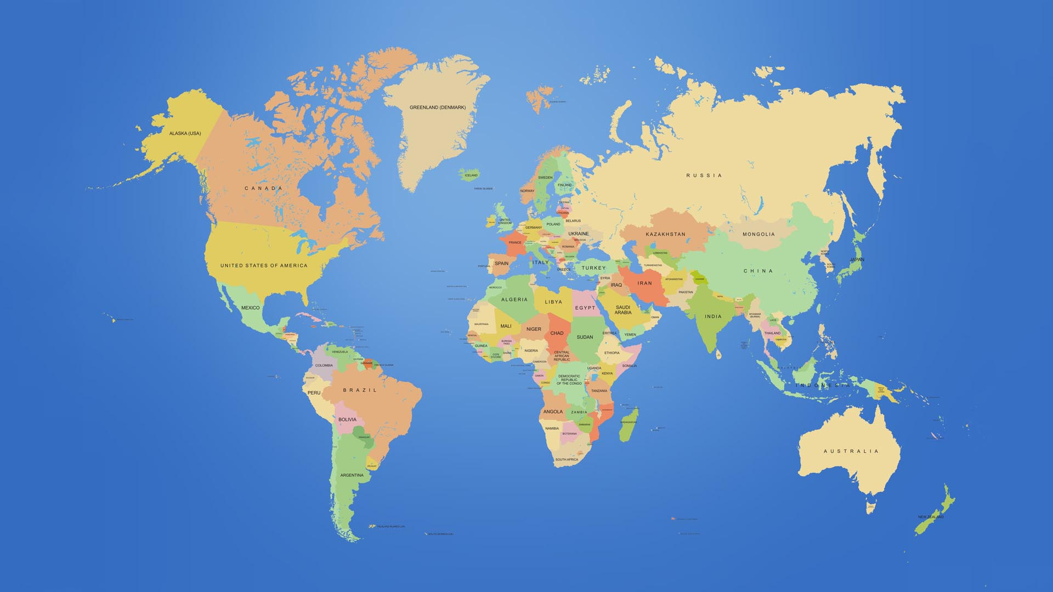
NGB's that have full and provisional membership and Tech Congress privileges
PROVISIONAL
Antigua & Barbuda
Argentina
Austria
Bermuda
Canada
Chinese Taipei
Colombia
Czech Republic
Guatemala
Guyana
Hong Kong
India
Italy
Kazakhstan
Kenya
Macao, China
Malta
Mexico
Philippines
FULL
Australia
Belgium
Botswana
Brazil
China
Denmark
Eswatini
Finland
France
Germany
Greece
Hungary
I.R. Iran
Japan
Korea
Malaysia
Mozambique
Pakistan
Puerto Rico
Singapore
South Africa
Sweden
Switzerland
Tanzania
Thailand
Trinidad & Tobago
Portugal
Russia
Slovakia
Uganda
United States

Slide 27
NGB's that have had Technical Congress representatives on voting calls in 2022
Australia
Austria
Belgium
Canada
China
Czech Republic
Denmark
Germany
Hong Kong
Japan
Portugal
South Africa
South Korea
Sweden
United States

Slide 28
May 29, 2022 Technical Congress Proposals- All passed
It has been proposed to change the weight of Difficulty skills to an exponent base of 1.5 with Presentation marks of + and - adjusted to a weight of 3 times their value in the dividend.
It has been proposed to update the athlete substitution rule as it has been presented to you.
It has been proposed to accept all other clarifications and grammar updates as they have been presented to you.

Slide 29
11. IJRU Technical Congress Updates
Motion 9: To approve the May 29, 2022 Technical Congress Proposals for the 2023 World Championships.

Slide 30
11. Repeated Skills Recognition
It is proposed that the recognition of repeated skills be moved to the difficulty judge
The difficulty judge will not make a skill mark if they believe a skill has been repeated in an exact manner.
The judge will mark the repeated skills button on the JRJ app when a skill is repeated
In making this mark, IJRU is able to collect data on the frequency of repeated skills, consistency of judging panels, and for judge training purposes

Slide 31
11. Space Violation for Coach's Box
Individuals who are not competing who enter the competition floor during the event should remain in the coach's box during the timing of the event
It could possibly be distracting to athletes, judges, or impeded video replay cameras to have individuals moving freely on the competition floor.
Individuals within the coaches’ box must fully exit the designated area to receive a space violation

Slide 32
11. Clarification for Cross Ranking and Recompeting in Finals
Cross-ranking rule is unchanged, but a full example of its application has been added due to feedback that it was unintuitive with just the description alone
This especially clarifies that cross-ranking is just “combined” ranking but only applied to one of the categories used in the combined ranking, and the other one is awarded as normal.
Recompeting rule previously “Re-competing the `SRSE` 1x180 and `SRTU` Triple-Unders events in Finals will be optional for athletes who qualify.”, we got feedback that it was unclear if they had to qualify for both of these events to be eligible for this choice, and have therefore changed it to “or”

Slide 33
11. IJRU Technical Congress Updates
Motion 10: To propose that the IJRU National Governing Bodies shall convene for a virtual electronic vote, 30 or more days after the current Technical Congress rule change proposal for the 2023 World Championships is posted.

Slide 34
13. Commitee Reports
13.1 Ethics Panel
13.2 Coaches Certification Ad-Hoc Committee
13.3 Anti-Doping Panel

Slide 35
13. Commitee Reports

Slide 36
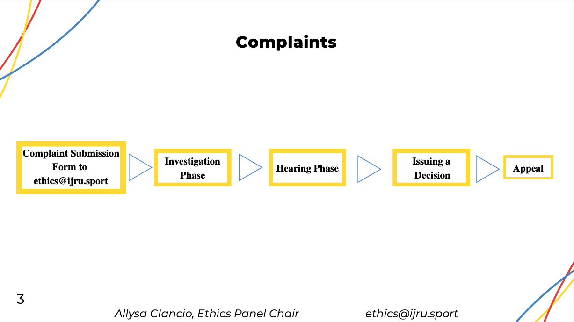

Slide 39
IJRU Jump Rope
Instructor and Coach Recognition Program

Slide 40
International Coach Recognition Program (ICRP)
The International Coach Recognition Program (ICRP) consists of 2 components:
The International Coach Certification Program (ICCP)
2. The International Registry of Jump Rope/ Rope Skipping Coaches (IRC)

Slide 41
International Coach Recognition Program (ICRP)
Objectives of the International Coach Recognition Program (ICRP):
Raise the standard of jump rope/ rope skipping instructors/ coaches around the world - - via well developed and holistic coach development programs and courses.
2. Raise public perception of jump rope/ rope skipping instructors/ coaches
- A registry will give the public assurance that their chosen instructor or coach is certified and qualified.
3. Encourage instructors and coaches continual education
incorporate a coach continual education (CCE) framework to keep coaches updated and up-skilled.

Slide 42
The International Coach Certification Program (ICCP)
The International Coach Certification Program (ICCP) is an enhanced training and development pathway for all jump rope / rope skipping coaches in the community, clubs or high performance sport programs.
The aim is to establish a training and development system to develop high quality and professional coaches.
Coaches trained in this program will gain multi-dimensional skills in the area of sports science, coaching, life skills, evidence-based practices and will be able to promote social values and principles.

Slide 43
The International Coach Certification Programme (ICCP)
The International Coach Certification Program (ICCP)
The programme consists of 4 progressive phases targeted at various development levels (Community, Foundation, Development and Developer) with 3 main components.
These 3 components are:
• Sports Science - covers various disciplines of sports science such as psychology, nutrition, biomechanics, physiology and strength and conditioning.
• Theory – covers the general principles of coaching such as sport pedagogy, fundamental movement skills, sport safety and management, effective communication, sports eco-system as well as teaching of values and principles
• Technical – covers sport-specific considerations such as sport demands, specific training methodologies, techniques, and sport strategies.

Slide 44
The International Coach Certification Programme (ICCP)
The International Coach Certification Program (ICCP)
Coach Development Pathway
Instructor Level is designed for individuals who wish to be an Assistant Coach mainly in Learn-to-Play Programs
Coach Level One is designed for individuals who wish to coach novice participants in community and / or youth sport.
Coach Level Two is designed for coaching competitive athletes. Specialised topics in these courses include the development of annual periodisation plans, training methodologies, test and measurement, sports science applications, social values and principles, and sport analyses.
Coach Developer/ Trainer. is design for individuals to become coach developer (CD). The role of a CD is a combination of training the trainer and mentoring, with a focus on supporting the coach on the job. The CDs role is to provide ongoing support, advice and encouragement to the coach. The key focus is hands-on helping the coach with the art of coaching.

Slide 45
The International Coach Certification Programme (ICCP)
The International Coach Certification Program (ICCP)
Implementation
Instructor Level Course: This course is ready for trial runs and will be open for registration between January to February 2023.
- Fully Online course with 80 percent E-learning and 20 percent live classes.

Slide 46
International Registry of Jump Rope/ Rope Skipping Coaches (IRC)
The International Registry of Jump Rope/ Rope Skipping Coaches (IRC) aims to raise the standard and professionalism of jump rope/ rope skipping coaching internationally.
It aims to ensure that coaches meet baseline qualifications, that coaches continue to practise and improve, and that coaches provide a safe environment for their athletes.
Today, there are estimated over 40,000 coaches around the world. These coaches can now choose to publish their profile via our online public database.

Slide 47
International Registry of Jump Rope/ Rope Skipping Coaches (IRC)
Coaches in the IRC are duly certified under International Coach Certification Program and must hold Standard First Aid certification (including CPR&AED) and undergone Safe Sport Education. They are committed to abide by the IJRU Coach’s Code of Ethics and meet the requirements for the Continuing Education Program.
This is part of the quality assurance to users of their coaching services that the coaches registered under IRC are up-to-date in their coaching knowledge and skills.
Through IRC, IJRU aims to give recognition to coaches who have been certified and deemed competent through ICRP or their National body. Doing so also allows the public to have easy access to qualified and professional jump rope/ rope skipping coaches.

Slide 48
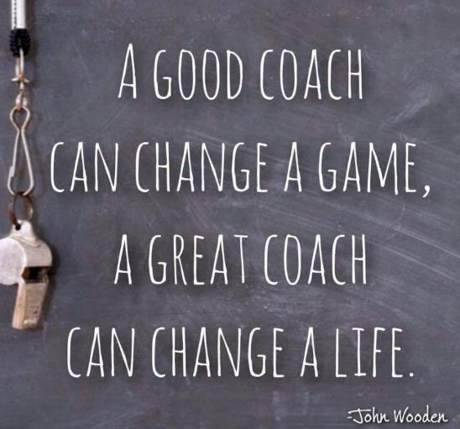
Notes:
Check out question if there is time – Get everyone to stand in a circle and share on this question. Get participants to reflect this in their coaching philosophy

Slide 49
13.3 Anti-Doping Panel
13.3.1 Anti-Doping Panel – IJRU is the WADA Signatory for Jump Rope.

Slide 50
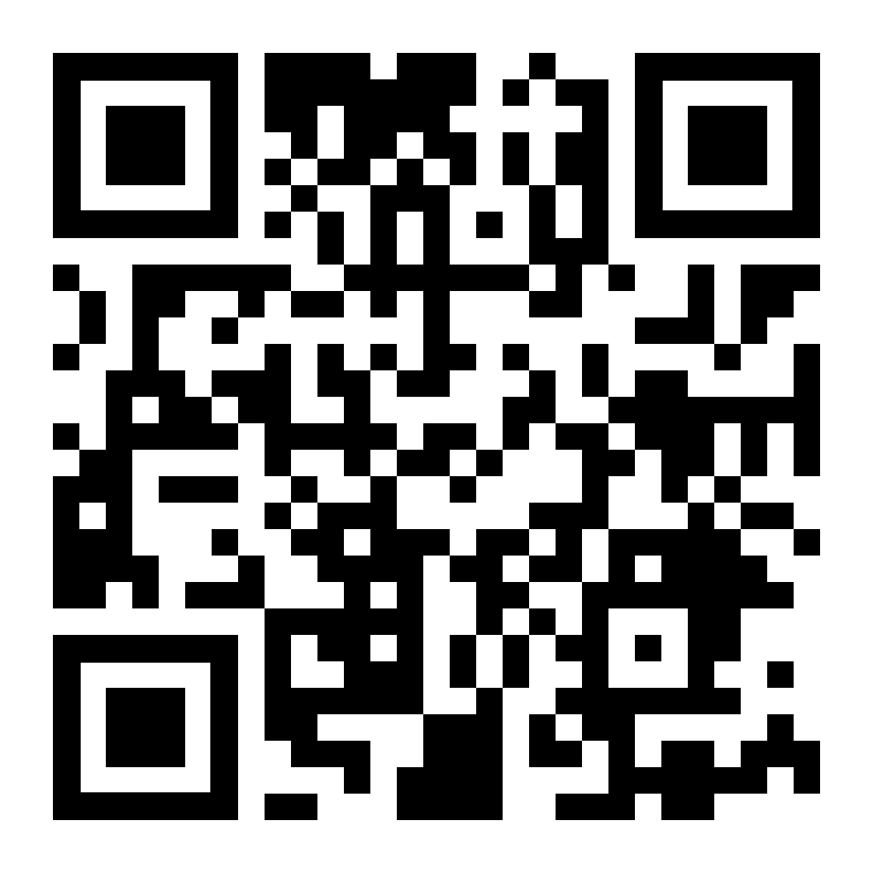
13.3 Anti-Doping Panel
13.3.2 WADA ADEL (Anti-Doping Education and Learning) Platform https://adel.wada-ama.org/learn
Push for athlete account creation
Follow the QR code for more info
13.3.3 WADA ADAMS (Anti-Doping Administration and Management System)
NGBs need to create athlete lists so IJRU can manually enter athletes https://adams-help.wada-ama.org/hc/en-us
13.3.4 2023 Prohibited List
The new list has just been approved and is presented in 10 languages www.wada-ama.org
QR code for WADA ADEL registration

Slide 51
13.3 Anti-Doping Panel
13.3.5 IJRU has an all-volunteer physician Therapeutic Use Exemption,
TUE, Committee
13.3.3 Compliance in the WADA Arbitral Award, Ends Dec. 16, 2022
“Raising the game for clean sport”

Slide 52
14. Championship Organising Committee
WC 2023 Colorado Springs
Competition dates 16-23 of July in “Ed Robson Arena”
Venue “El Pomar” will be warm up gym, practice gym, where meals will be served and athlete social hang out area.
Event folder in January 2023. All information will be included there (e.g. packages, meals, registration, judge nominations etc.)
Setting up information and Q&A meetings with all NGB’s (once a month) starting in end of October.

Slide 53
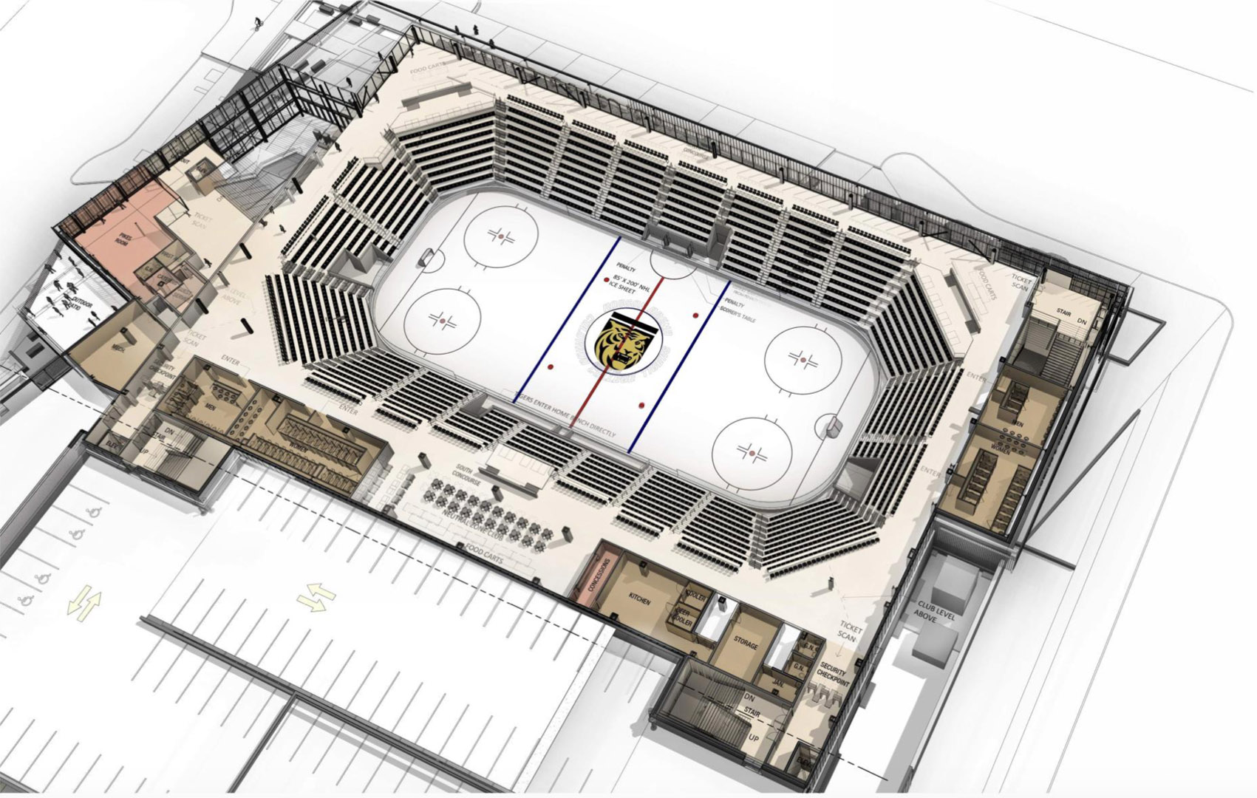
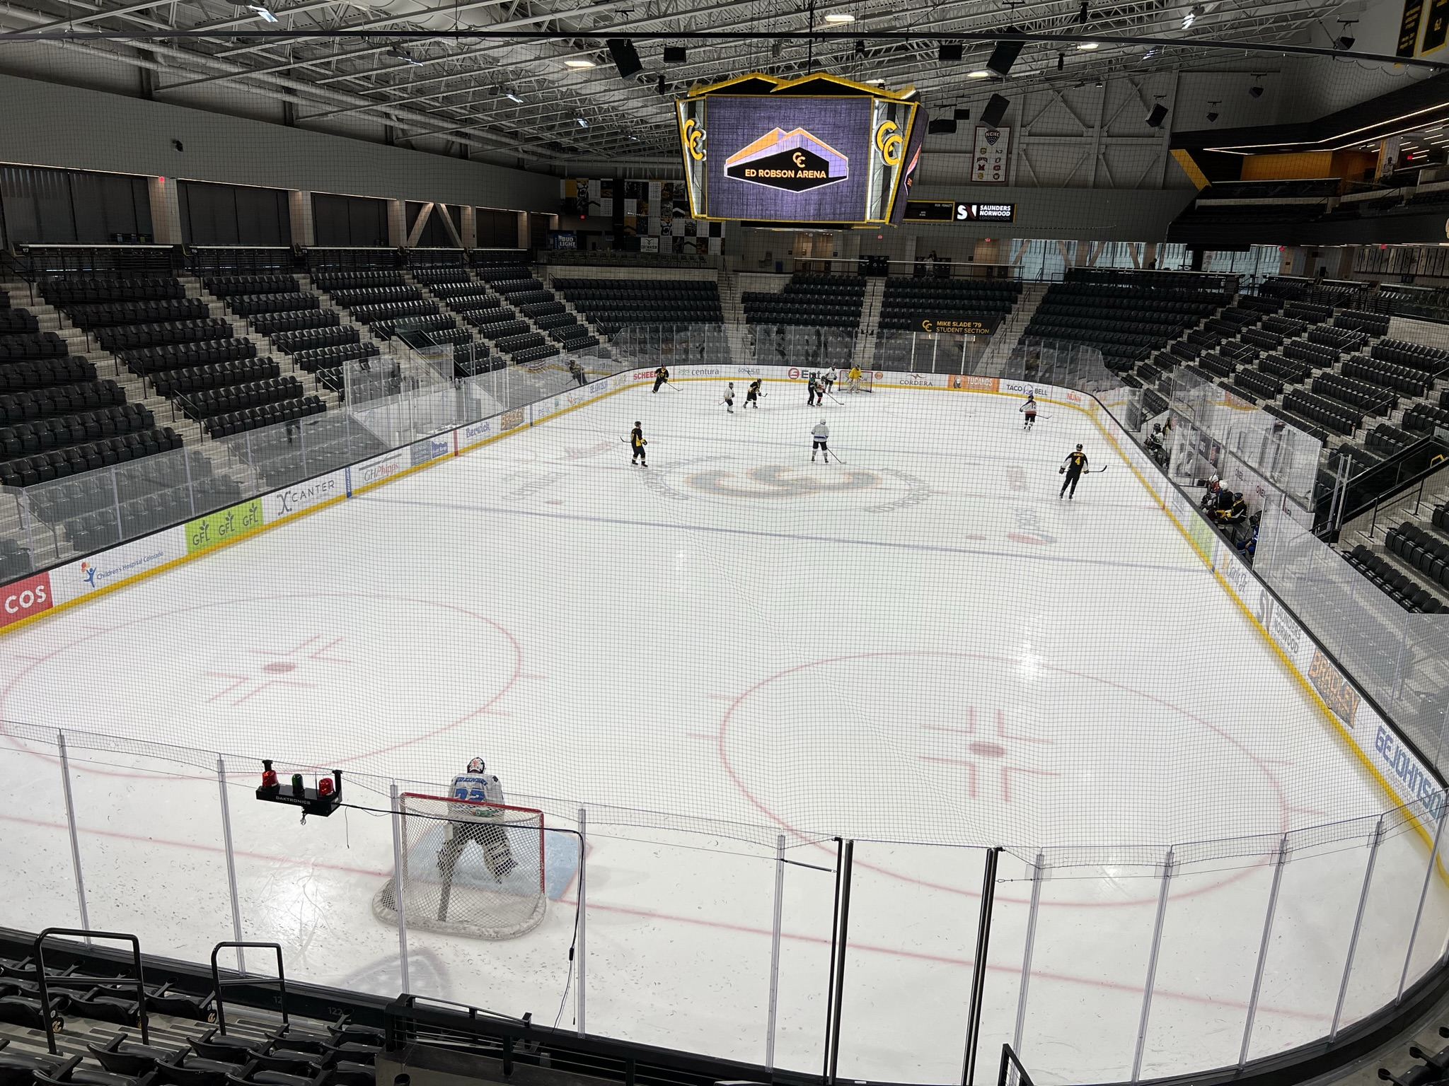
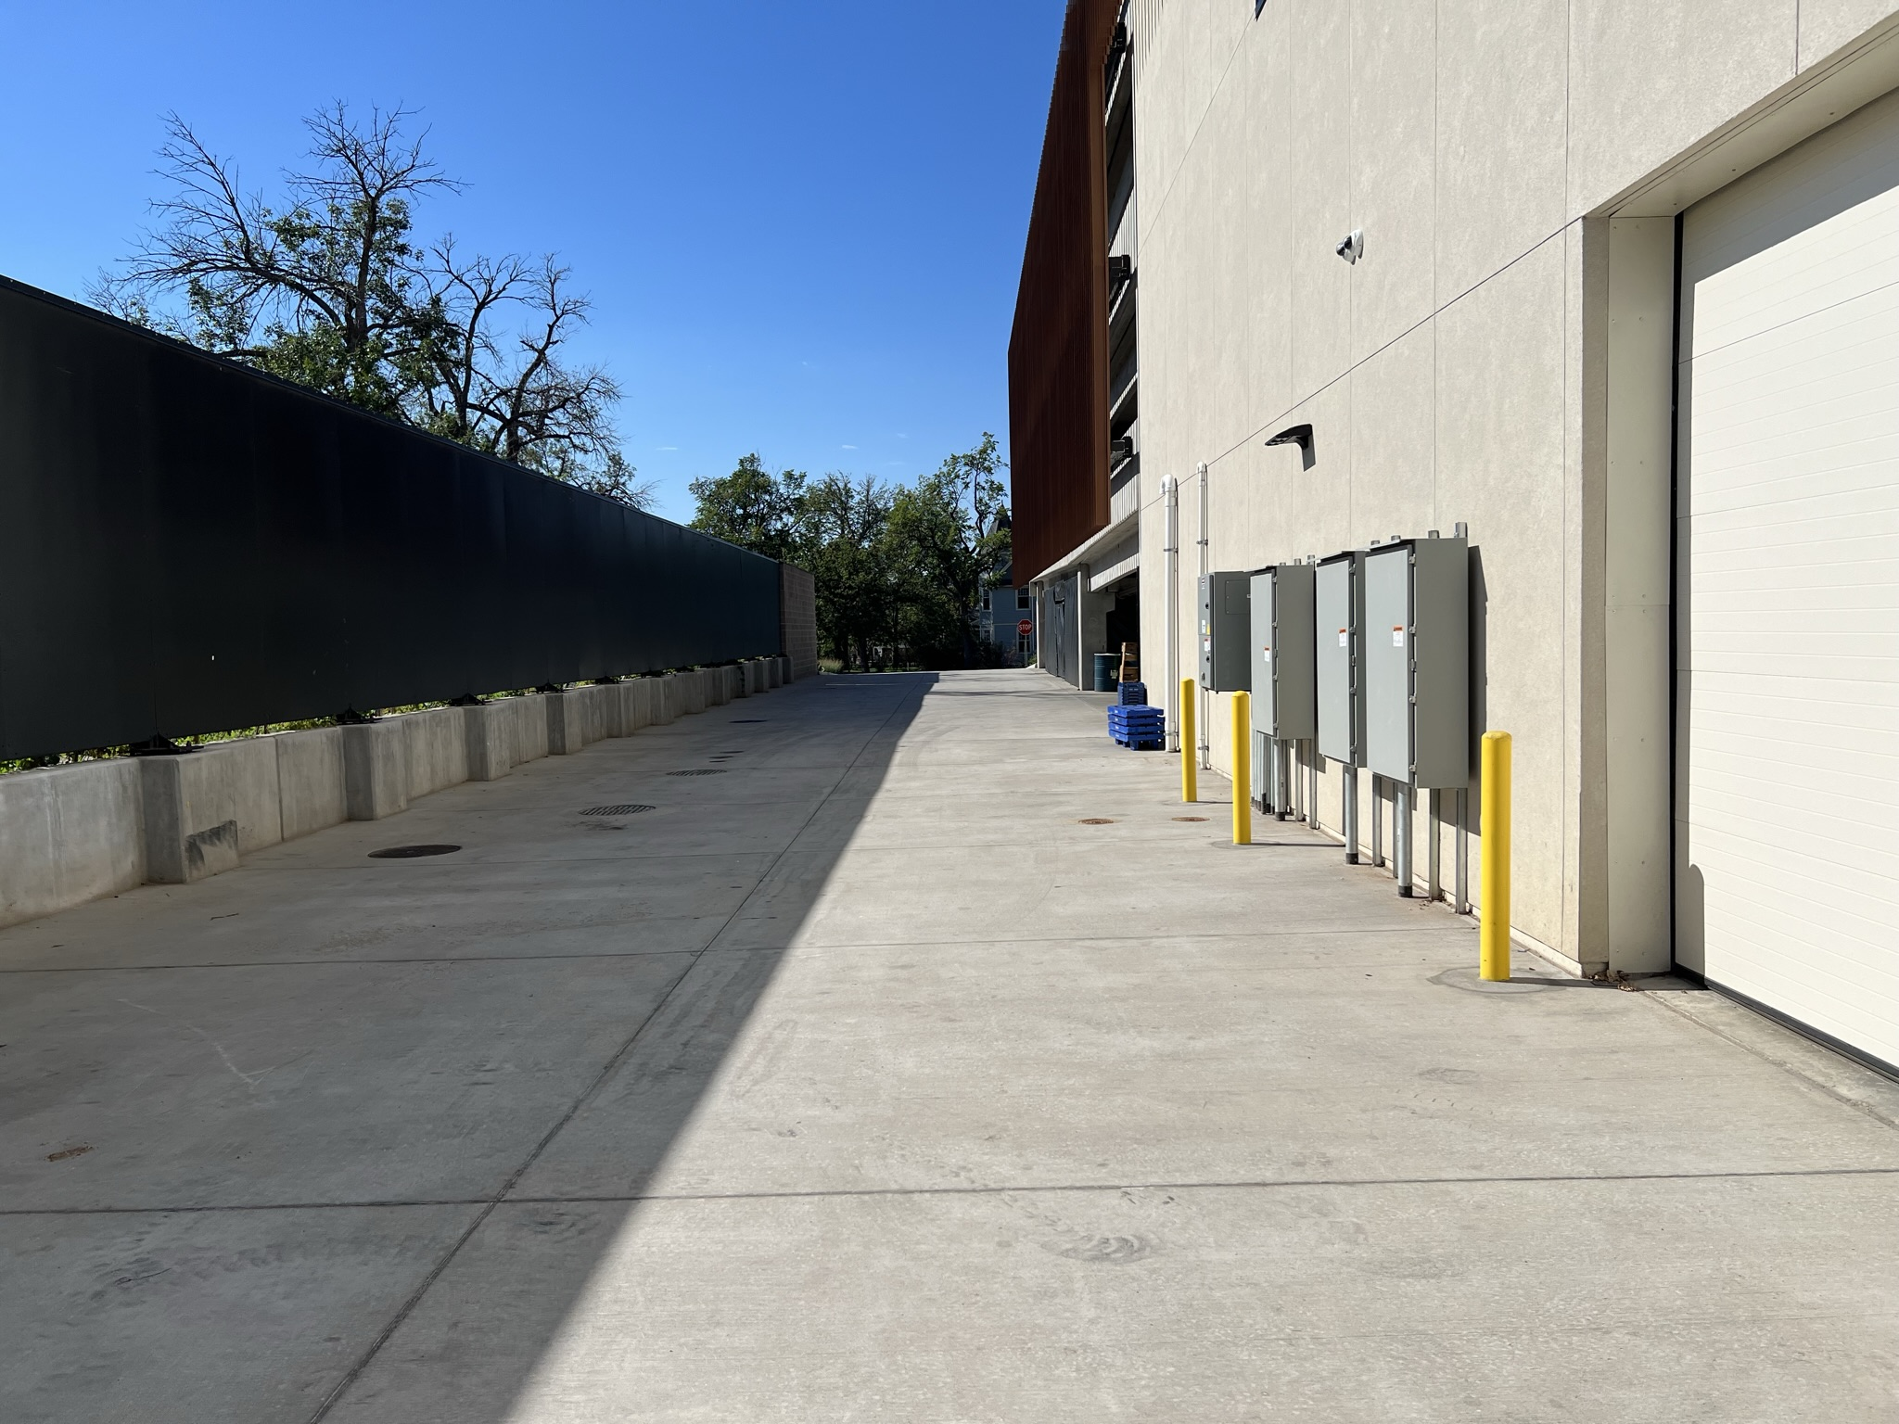
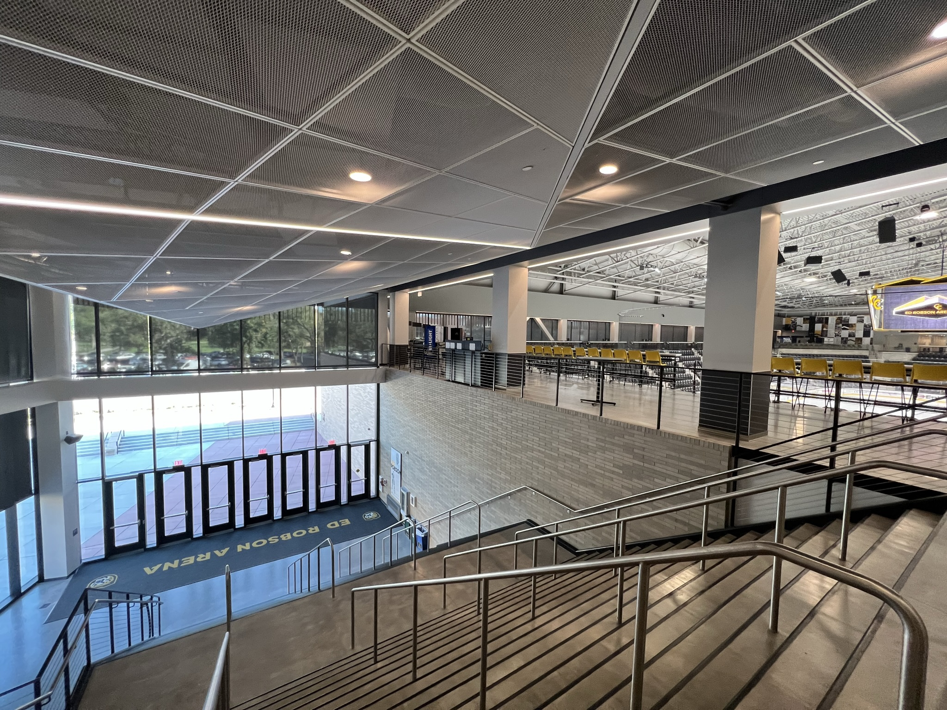
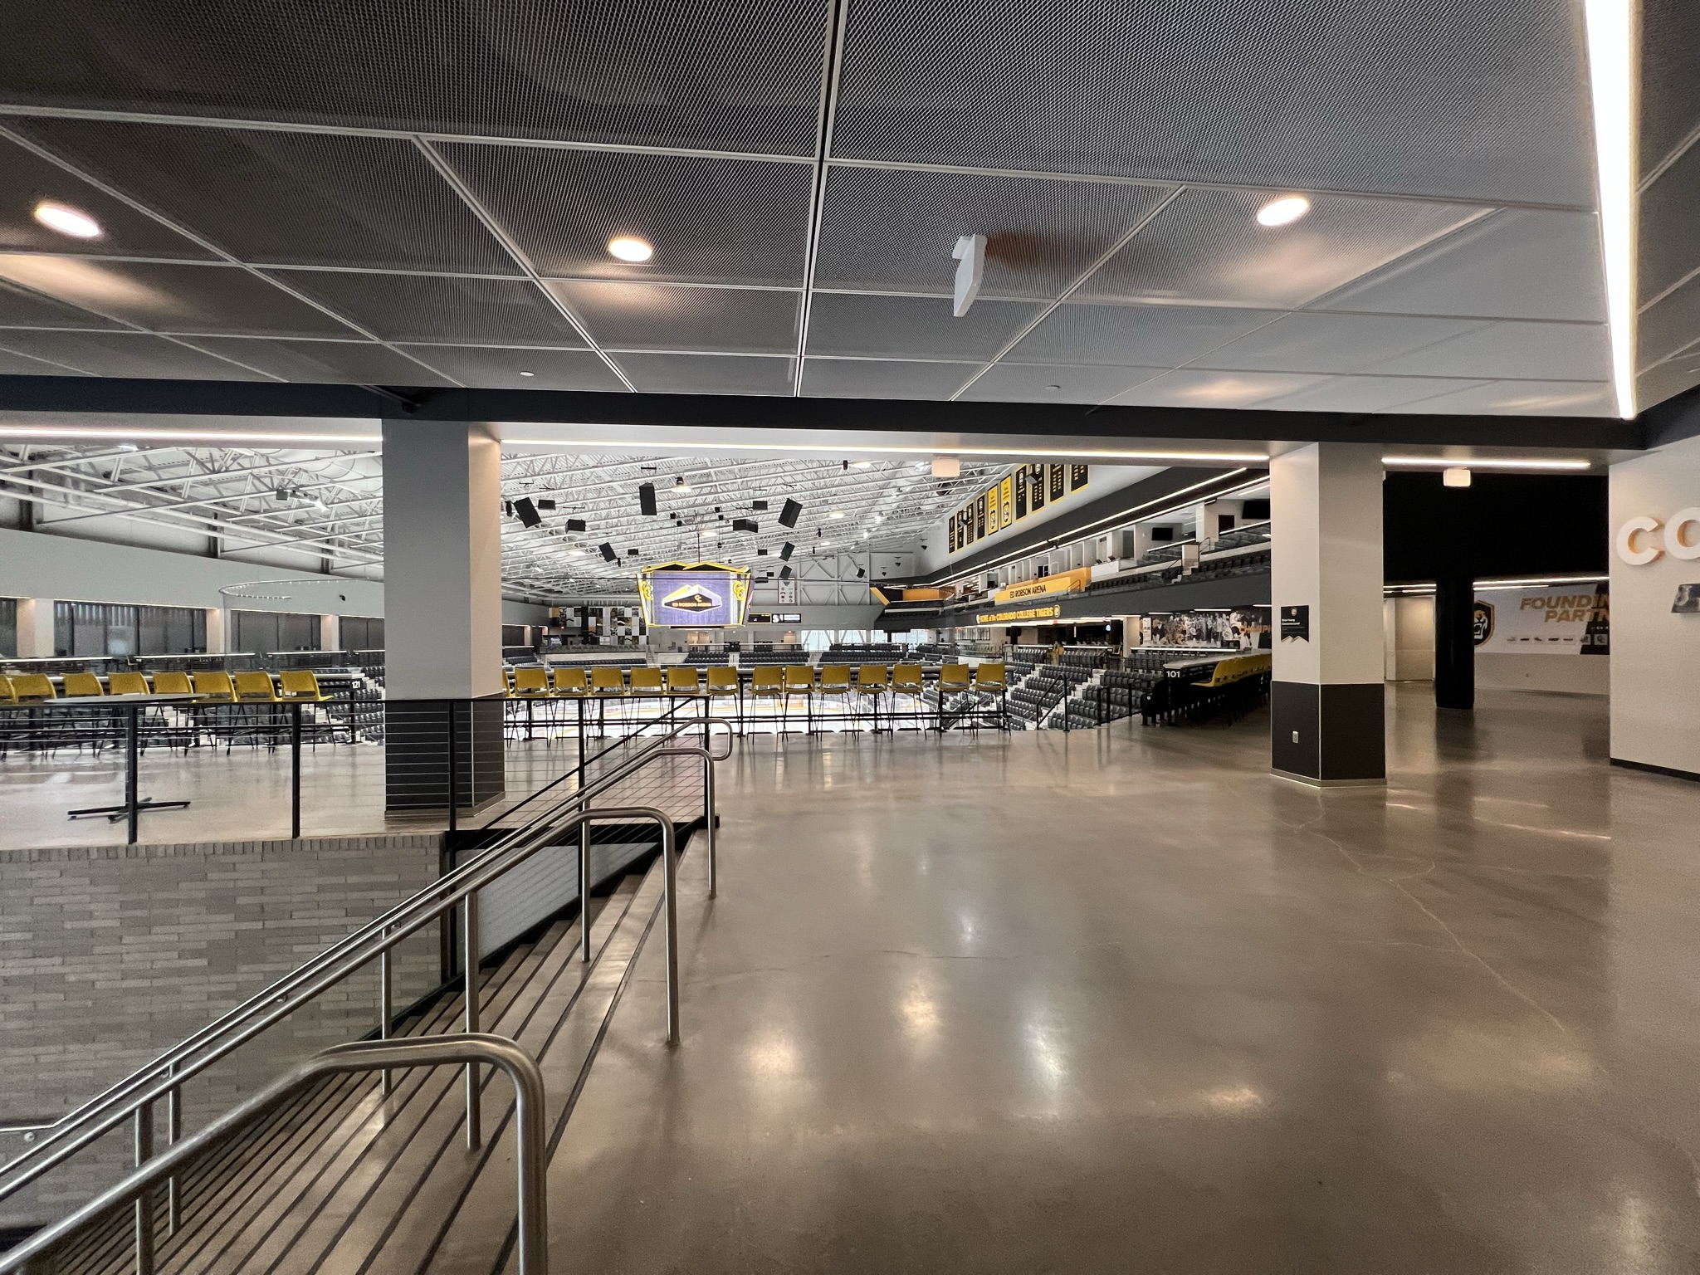
Ed Robson Arena
Audience entrance
Ice will not be there. Wooden floor
Prep area for competitors (will have sports flooring)

Slide 54
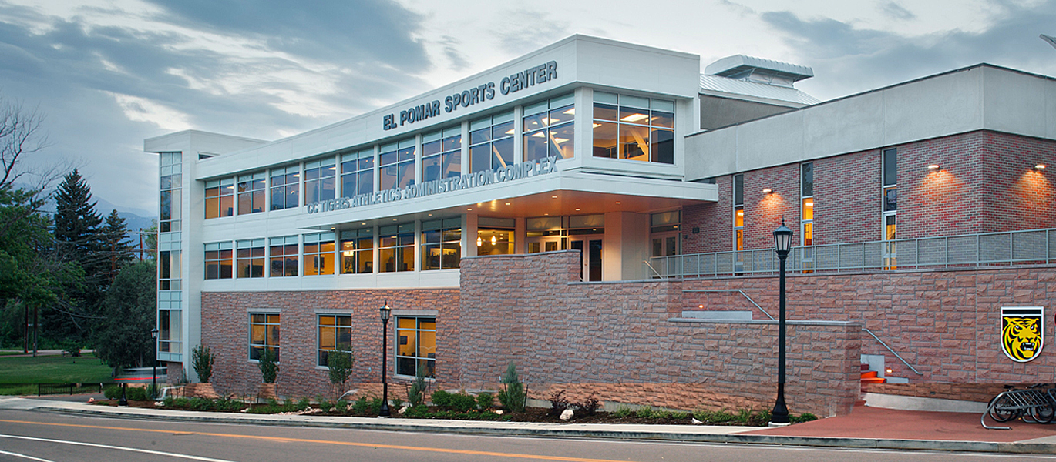
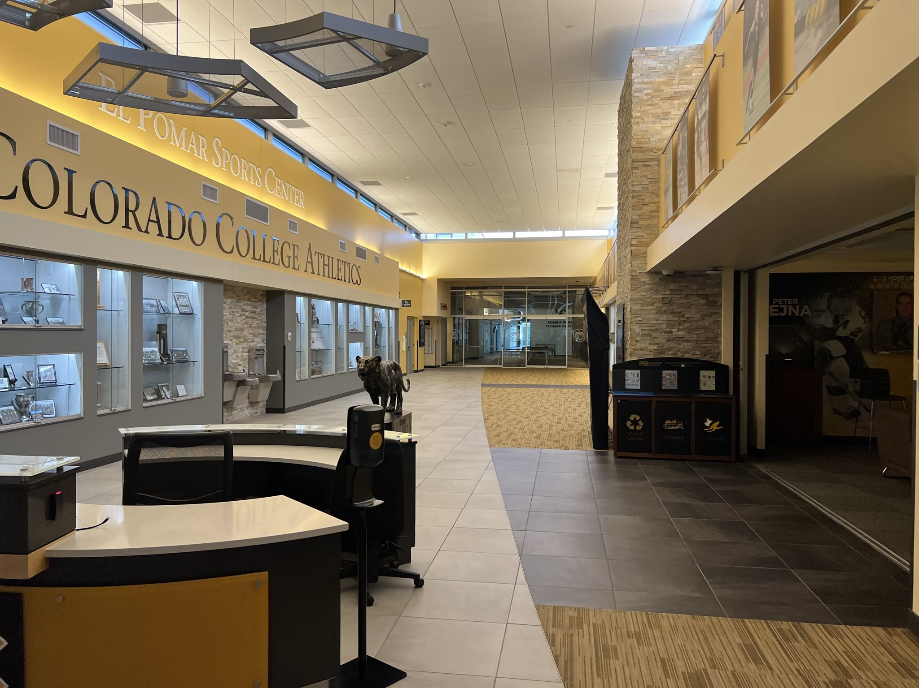
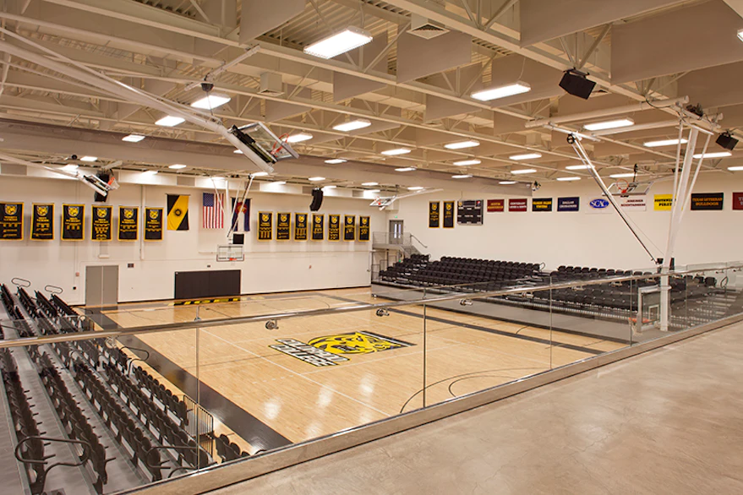
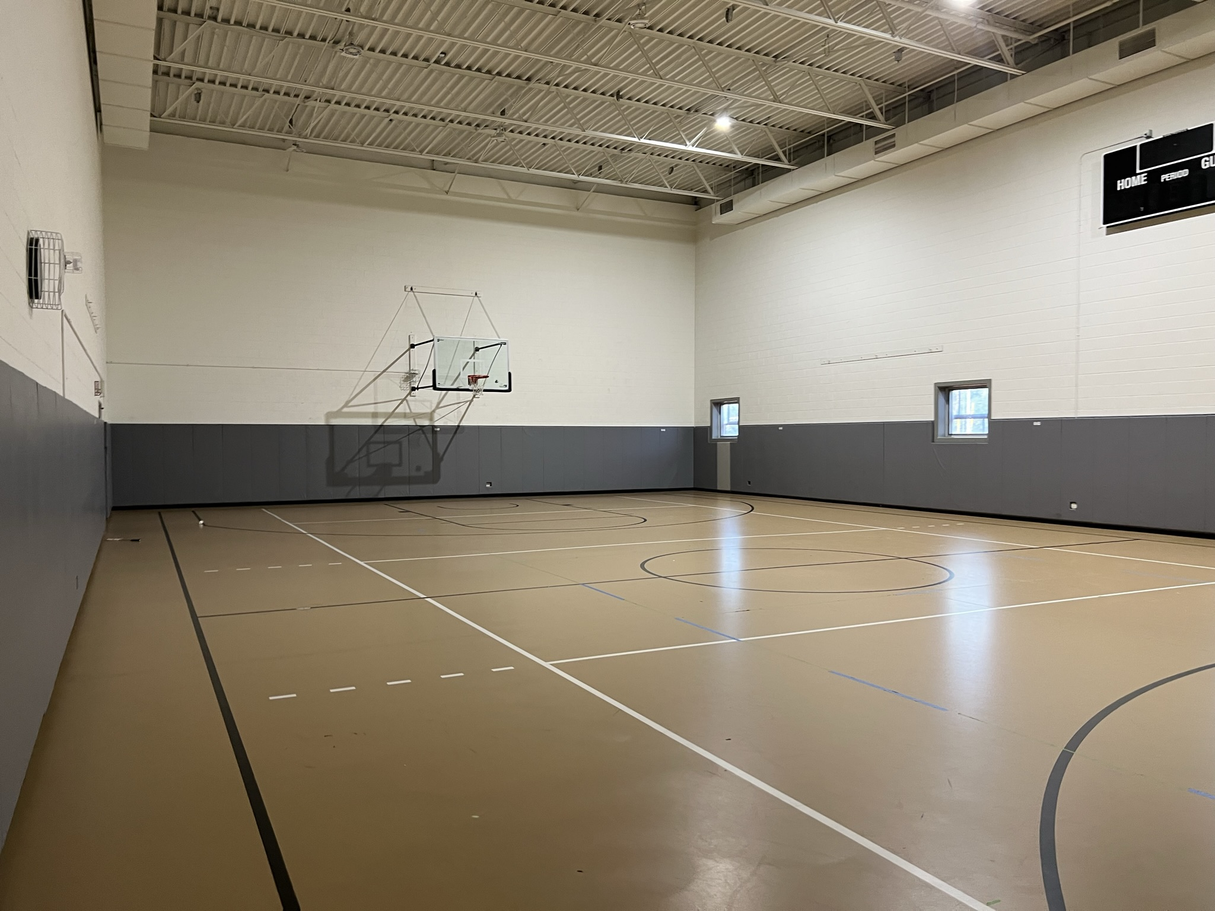
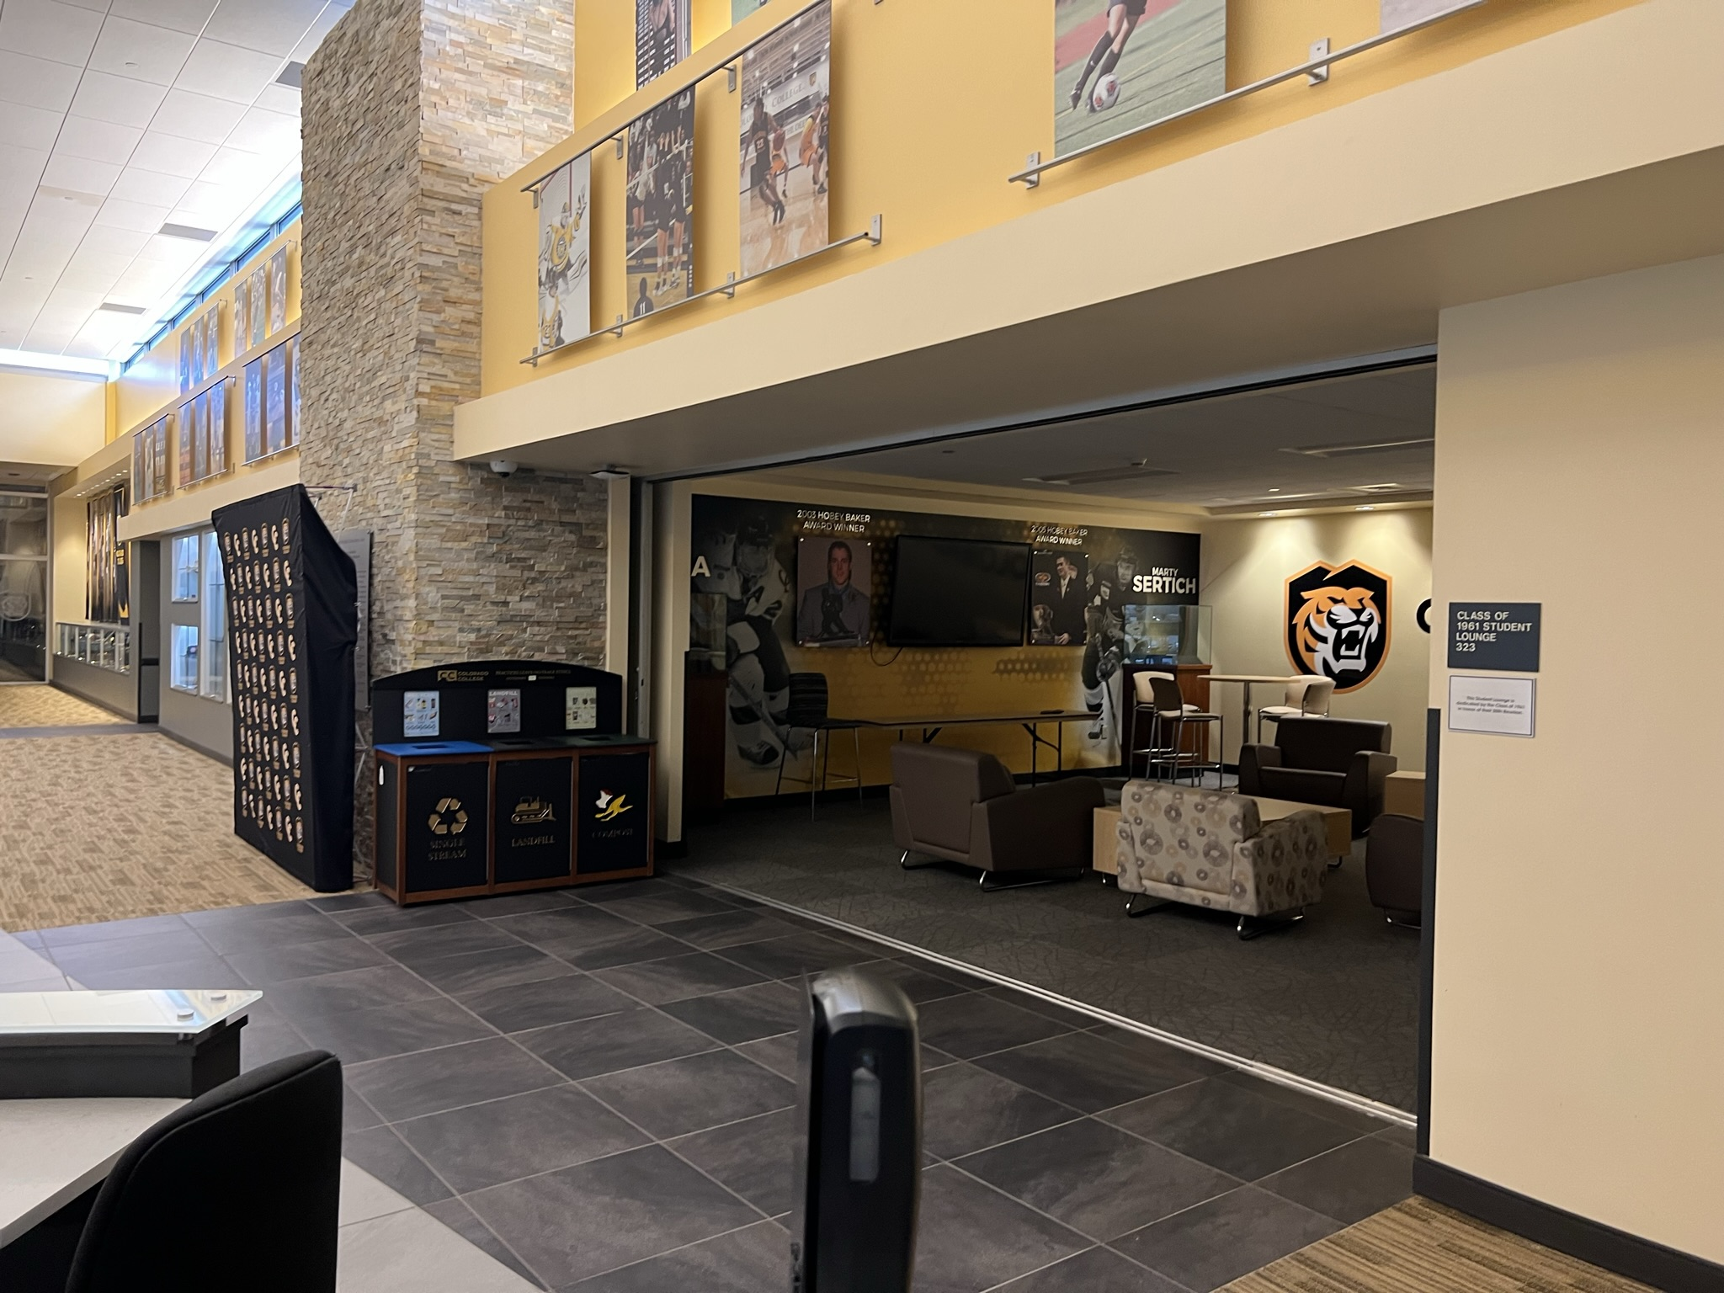
El Pomar Sports Center
Social hang out areas

Slide 55
Finance
We are doing out outmost to get the best solution for all involved when it comes to pricing of the event.
Financial Realities:
Four years since a world championship was held
Two years of pandemic
Global Inflation
Despite these realities, IJRU is working to make the event affordable and profitable.

Slide 56
Preliminary Competition Schedule
Sunday 16 July | Monday 17 July | Tuesday 18 July | Wednesday 19 July | Thursday 20 July | Friday 21 July | Saturday 22 July | Sunday 23 July
IOT Speed | IOT Freestyle | WC Master Freestyle | JWC & WC Master Speed | JWC & WC Team Speed SRTU* | WC Team Freestyle | DDC+ Finals | DDC+ Finals
IOT Freestyle | JWC Master Freestyle | JWC Team Freestyle | JWC Team Freestyle | WC Team Freestyle | Team Show |  | Gala
 | Opening Ceremony |  |  |  |  |  | Gala
* Subject to change
Note: Schedule practice on competition floor will be included in the finalized schedule

Slide 57
Registration Timeline
WC information and Q&A meeting for NGB’s monthly
Date | Activity | Comment
January 2023 | Event Folder
January 2023 | Pre estimation high level from NGB’s | In excel
March 2023 | Registration opens | Registration system
 | Judge nomination
1st of April 2023 | 1st round of entries close (no name)
1st of April 2023 | 30% payment
22nd of April 2023 | 2nd round of extra entries opens (no name)
1st of June 2023 | Final registration close (slots to be filled with names) | 75% refund
1st of June 2023 | Final Invoice
1st of June 2023 | Final Judge nomination
1st of July 2023 |  | 25% refund

Slide 58
Number of Entry
For JWC and WC each NGB can send three (3) entries for each event/gender.
Additional entry can be asked for
For IOT each NGB can send two (2) entries for each event/gender/age group
(12-15, 16-18, 19 +, 30+)
Additional entry can be asked for
For Double Dutch Contest each NGB can send one (1) entry for each event/category .
Additional entry can be asked for

Slide 59
Number of entries per NGB
Competition | Age Division | Team |  |  | Individual |  | Show
Gender Categories |  | Male, Female, Mixed (Open) | Male, Female, Mixed (Open) | Any gender | Male, Female |  | Any gender
Events |  | SRSR SRDR SRPF SRTF DDSR DDSS DDSF DDPF | Wheel Freestyle (WHPF) | DD Triad | SRSS SRSE SRIF | Triple Unders (SRTU) | Show Freestyle (SCTF)
International Open Tournament (IOT) | 12-15 | 2 teams per event and gender | 2 teams per event and gender |  | 2 athletes per event and gender
 | 16-18 | 2 teams per event and gender | 2 teams per event and gender |  | 2 athletes per event and gender | 2 athlete per event and gender
 | 19+ | 2 teams per event and gender | 2 teams per event and gender |  | 2 athletes per event and gender | 2 athlete per event and gender
 | 30+ | 2 teams per event and gender | 2 teams per event and gender |  | 2 athletes per event and gender | 2 athlete per event and gender
Junior World Championship (JWC) | 12-15 | 3 teams per event and gender | 3 teams per event and gender |  | 3 athletes per event and gender
Senior World Championship (WC) | 16+ | 3 teams per event and gender | 3 teams per event and gender | 3 teams per event | 3 athletes per event and gender | 3 athletes per event and gender
Show Competition (SC) | 12+ |  |  |  |  |  | 1 team
Competition | Age Division | Team
Gender Categories |  | Any Gender
Events |  | Performance
 |  | Speed
Double Dutch Contest | 12-15 | 1 team per event
 | 16+ | 1 team per event
If any NGB have qualification competition for DDC please use below for number of entries:
1 Team ～ 24 Teams→ 1 Team 25 Teams ～ 49 Teams→ 2 Teams 50 Teams ～ 74 Teams→ 3 Teams 75 Teams ～ 99 Teams→ 4 Teams Over 100 Teams→ 5 Teams

Slide 60
15. Global Affiliations
15.1 International Sport Overview
15.2 GAISF and AIMS Update and IJRU Recognition Status
15.3 Recognition Matters: NGB Recognition Success

Slide 61
16. Adjournment
Please plan now to attend the 2023 IJRU General Congress in Colorado Springs, Colorado, USA.
IJRU has already started planning for our 5th General Congress that is anticipated to be held during the World Championships.

